Slide 1
Exploratory Data Analysis (EDA) for Real Estate Pricing:
Name: Priti Mohan kalaskar
Organization: NextHikes IT Solutions

Slide 2
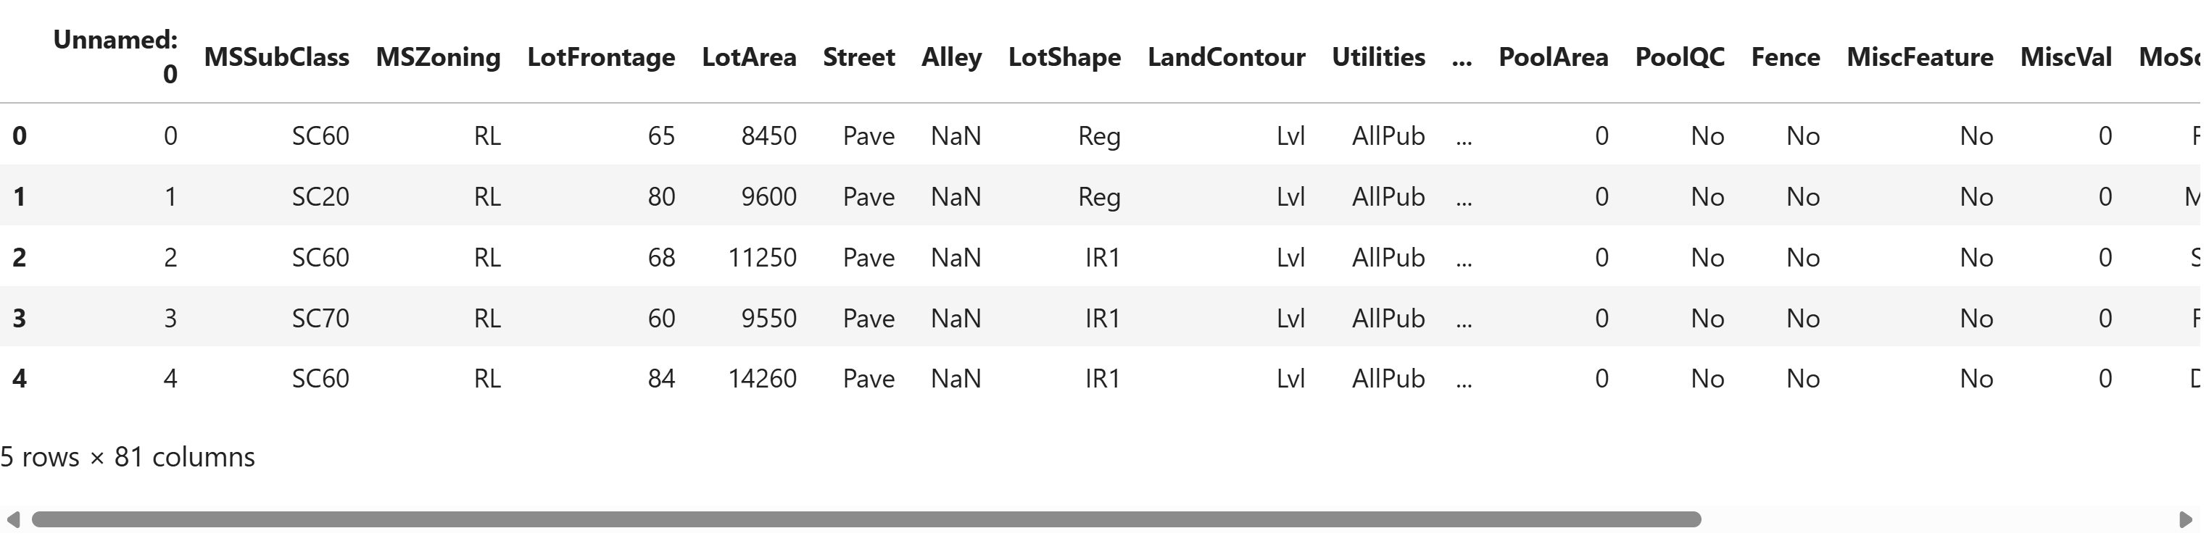
Dataset Overview

Slide 3
List of Tasks
Data Collection
Data Cleaning
Univariate Analysis
Bivariate Analysis
Multivariate Analysis
Feature Engineering
Feature Engineering and Size Impact
Market Trends and Historical Pricing
Customer Preferences and Amenities
Outliers Processing(Find and Removal)
Skewness and kurtosis calculations.

Slide 4
Data Collection and Cleaning
Load the Data.
Drop columns with more than 80% missing values.
Handle missing values.
Remove duplicate columns and rows.
Analysis of dependent and independents variables.

Slide 5
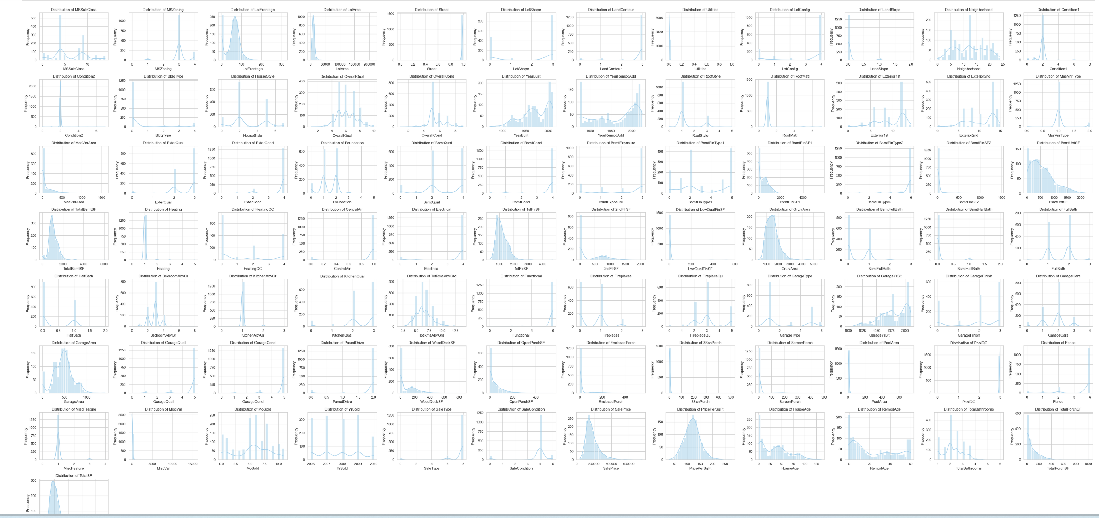
Univariate Analysis
Distributions and characteristics for each variable

Slide 6
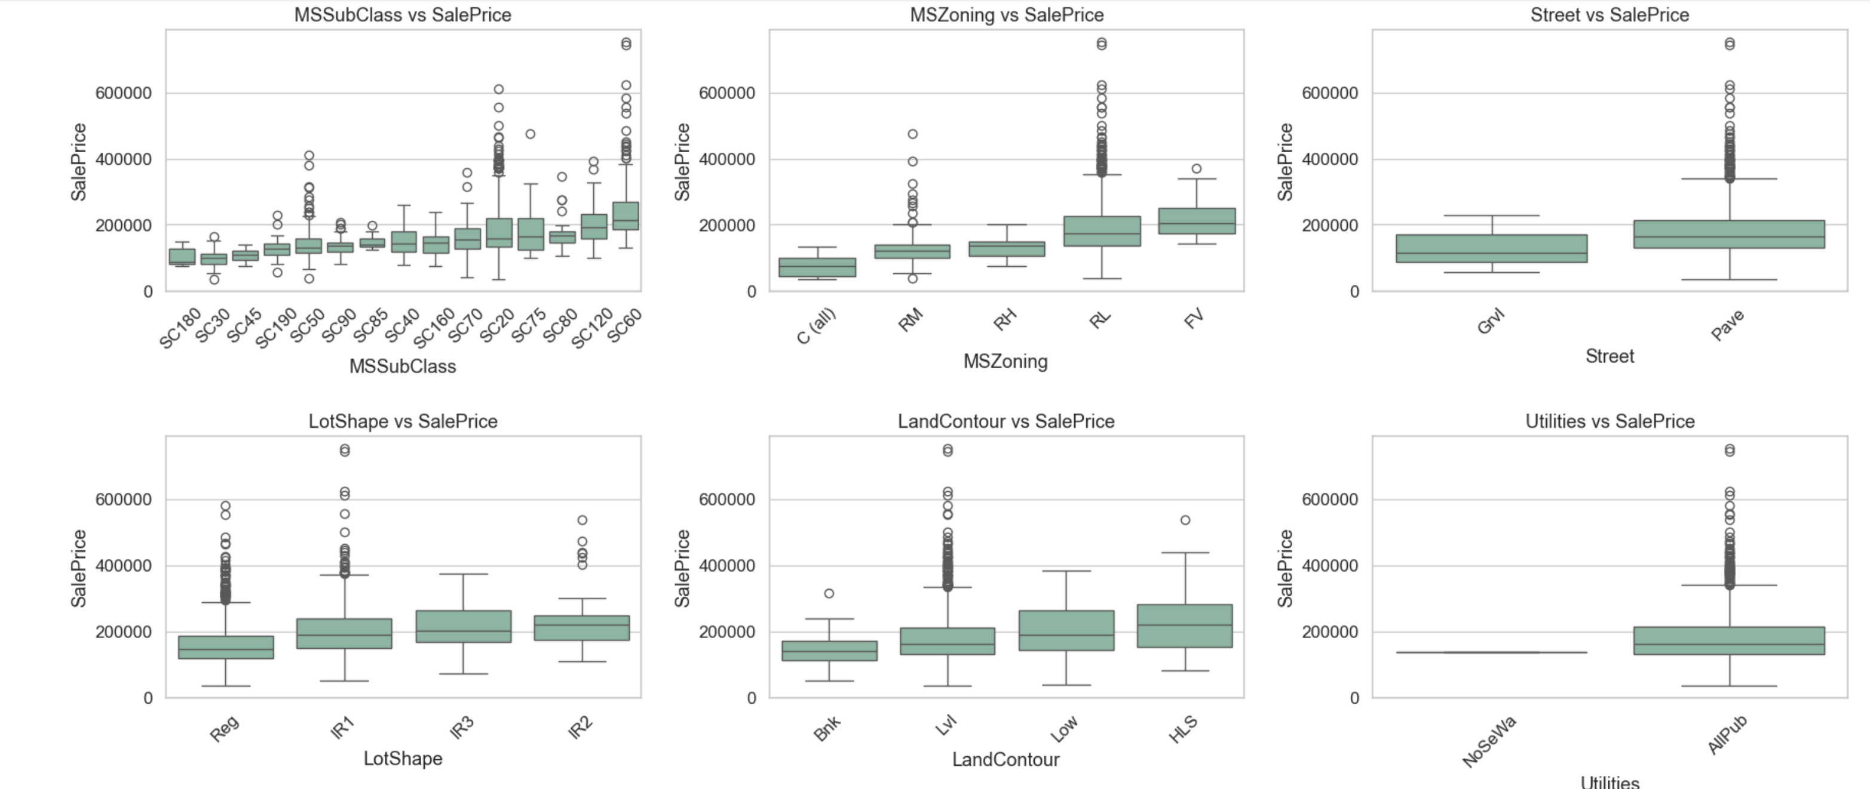
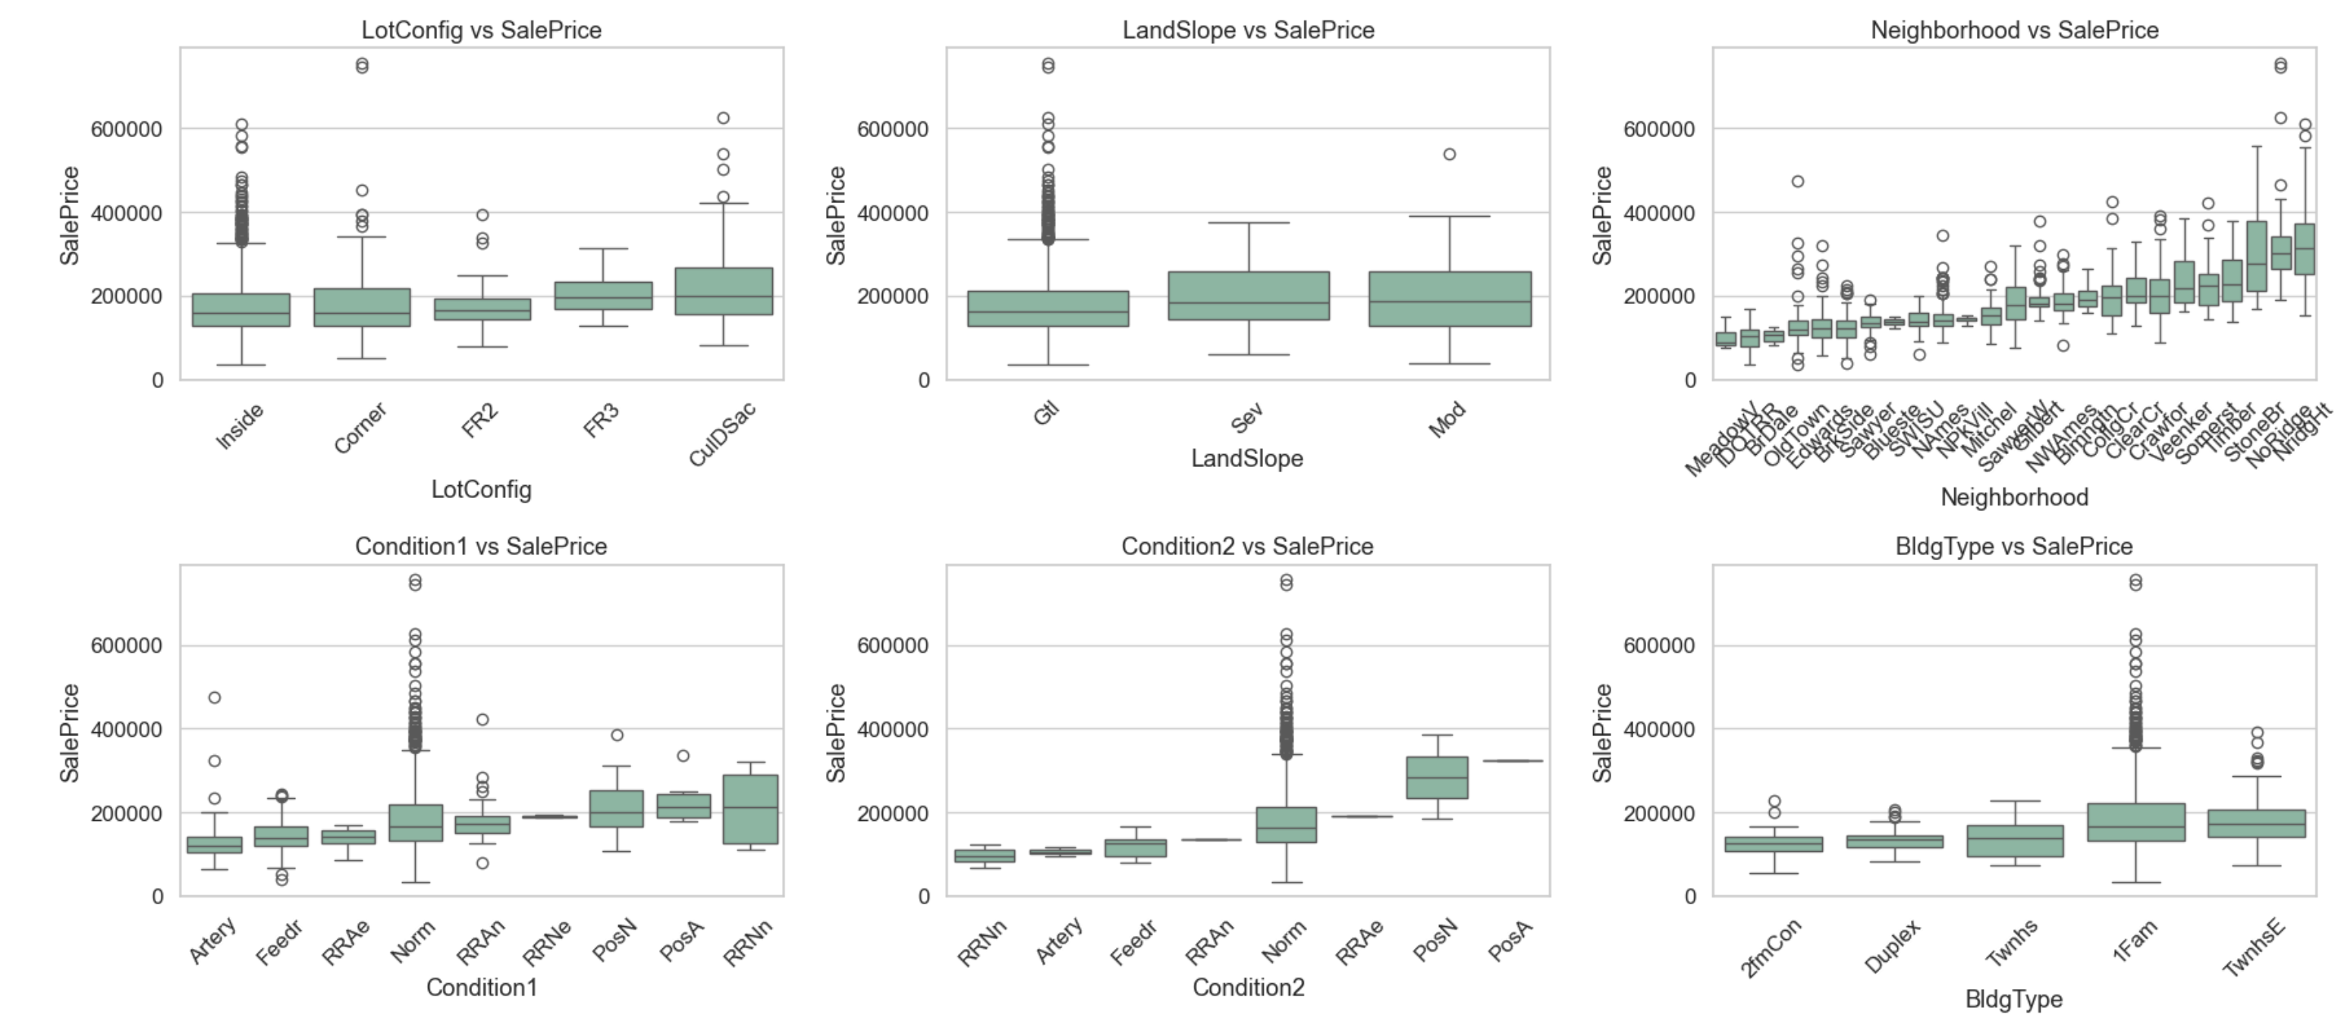
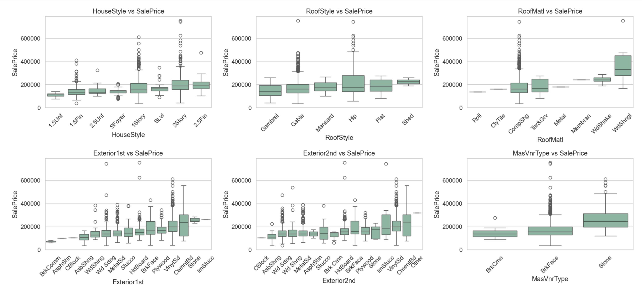
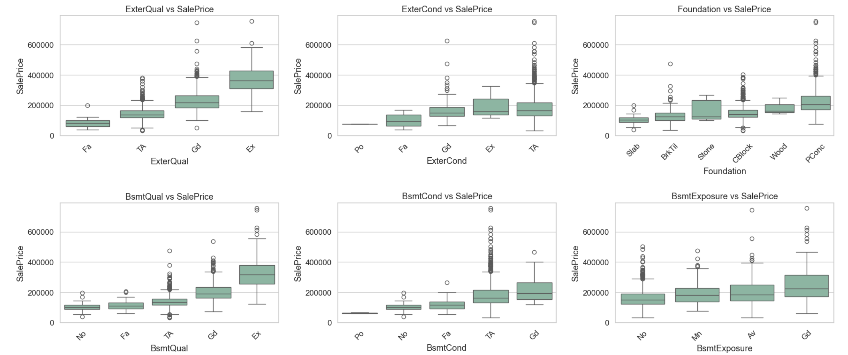
Bivariate Analysis
Impact of each variable on house prices

Slide 7
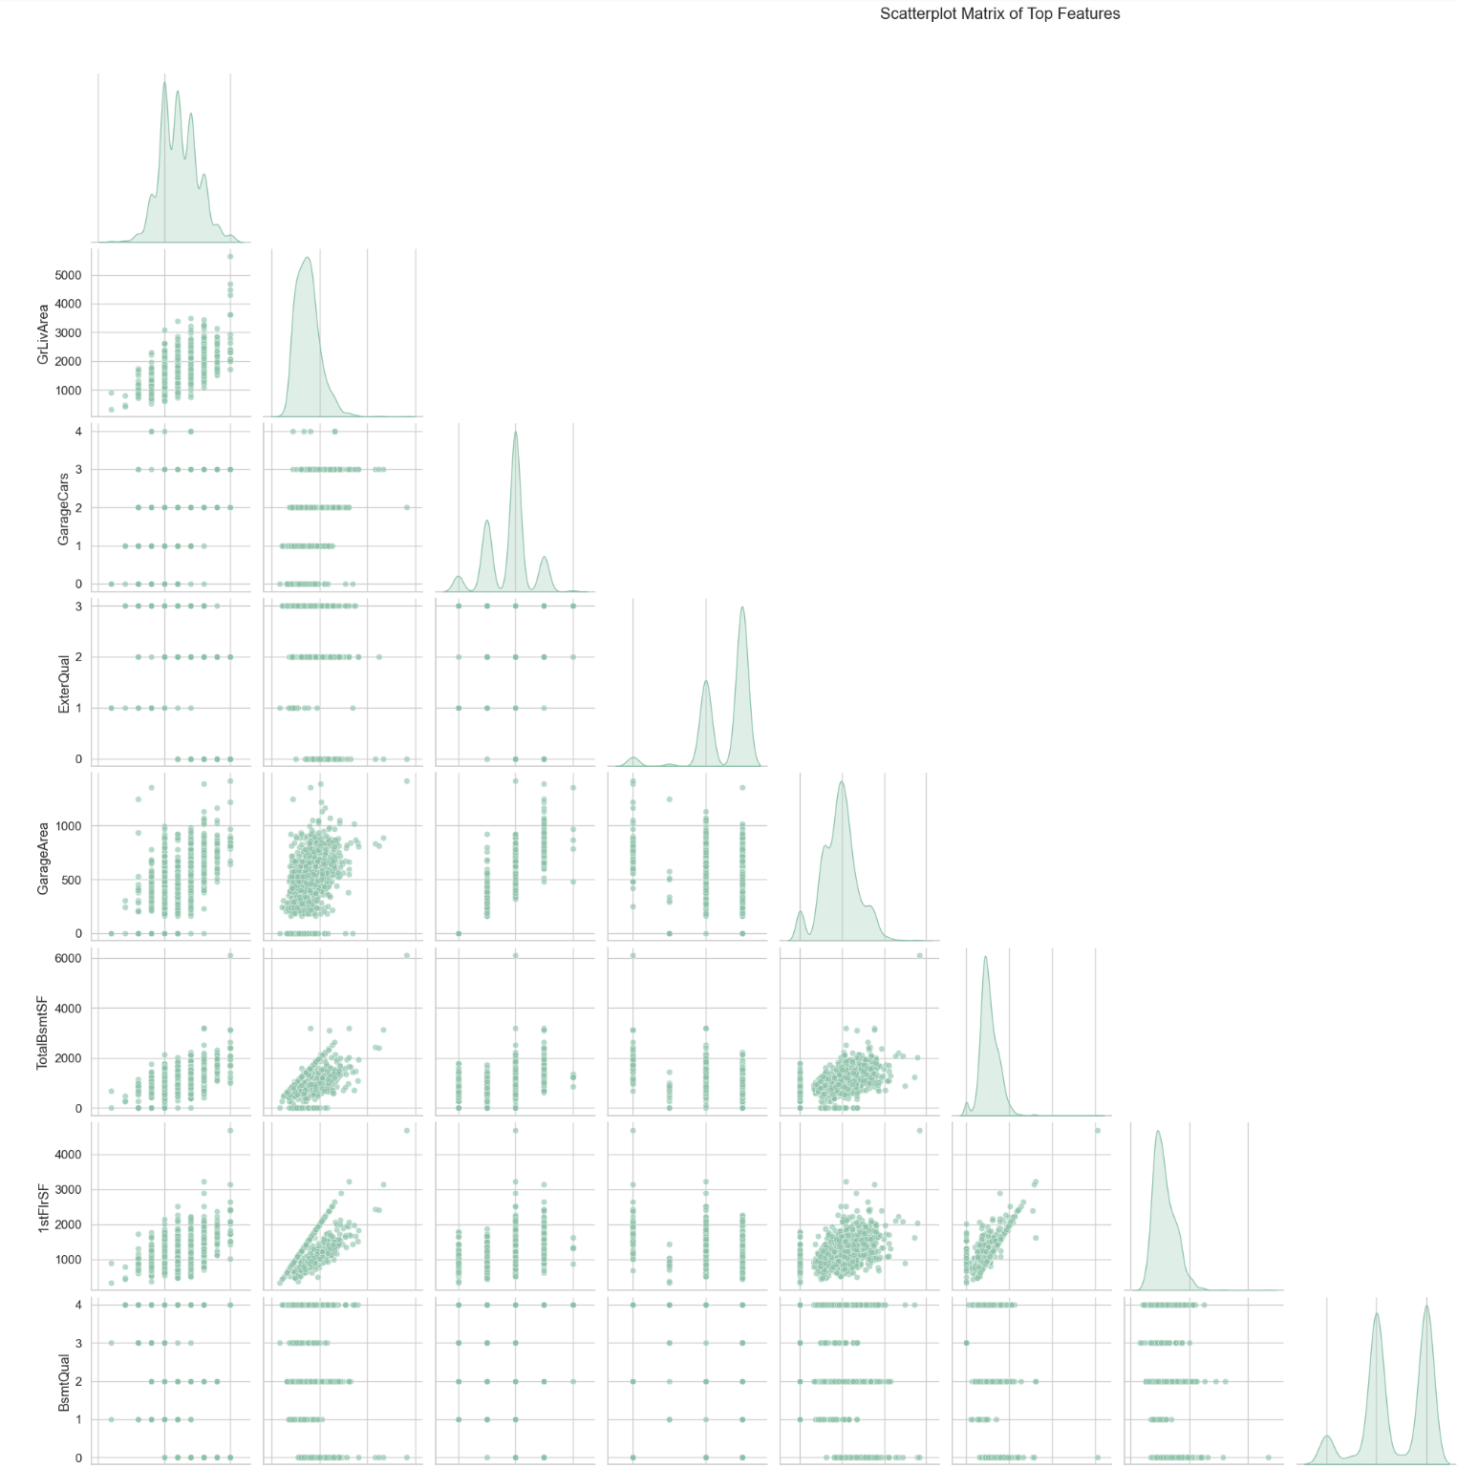
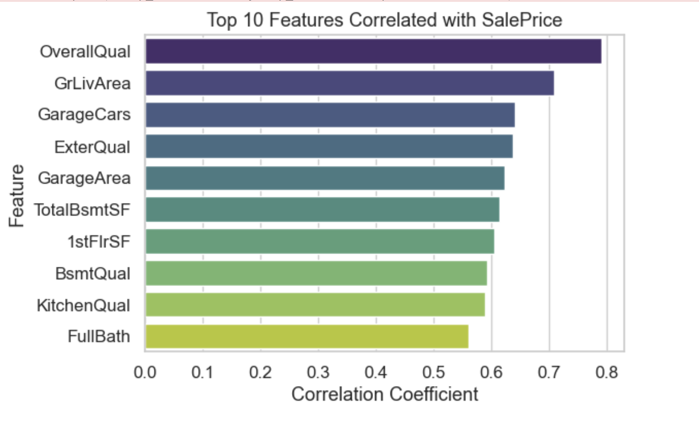
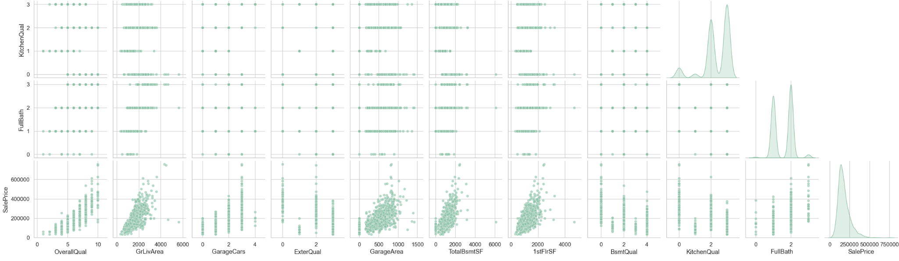
Multivariate Analysis
Relation of Top 10 Features with Sales Price

Slide 8
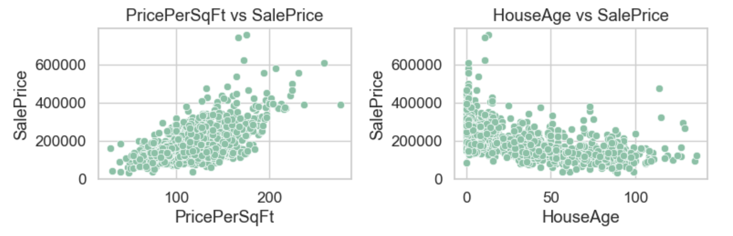
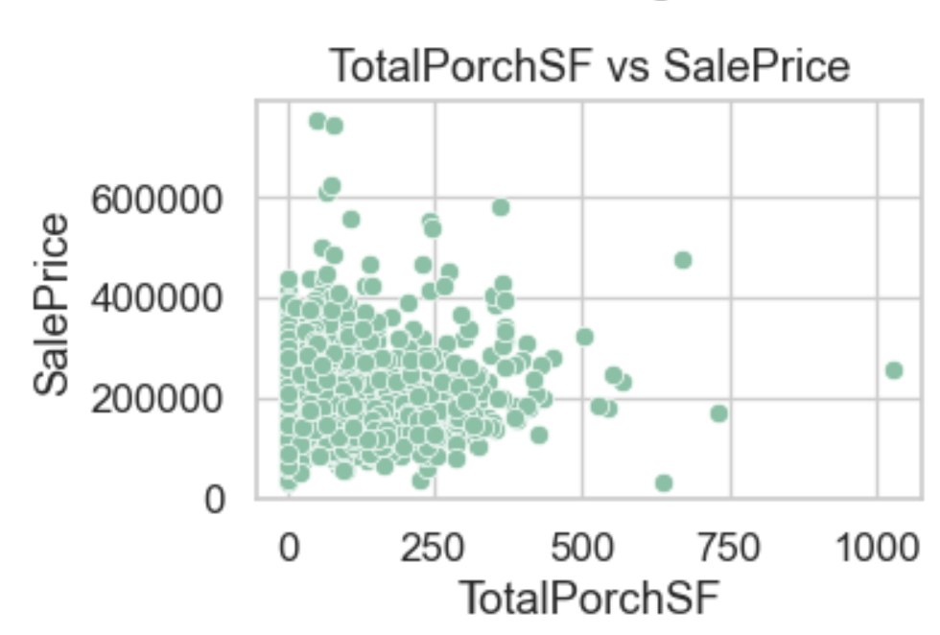
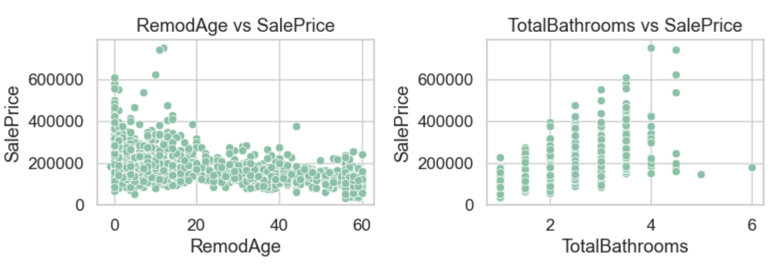
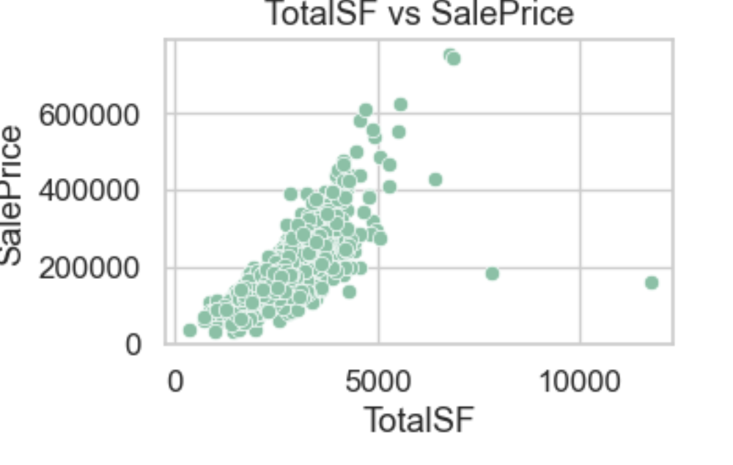
Feature Engineering
Generated New Features from combination of existing features .
Relationship of new features with Sales prices.

Slide 9
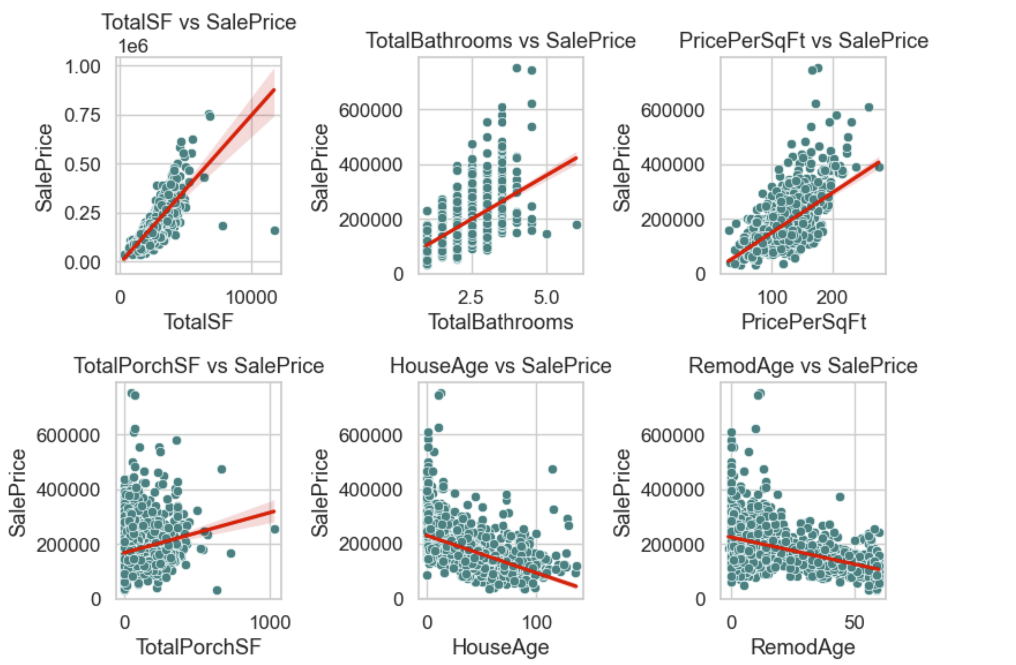
Feature Engineering and Size Impact

Slide 10
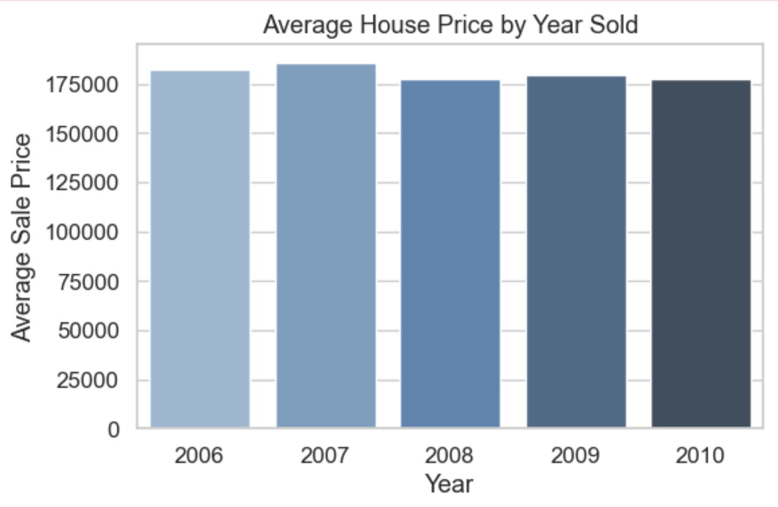
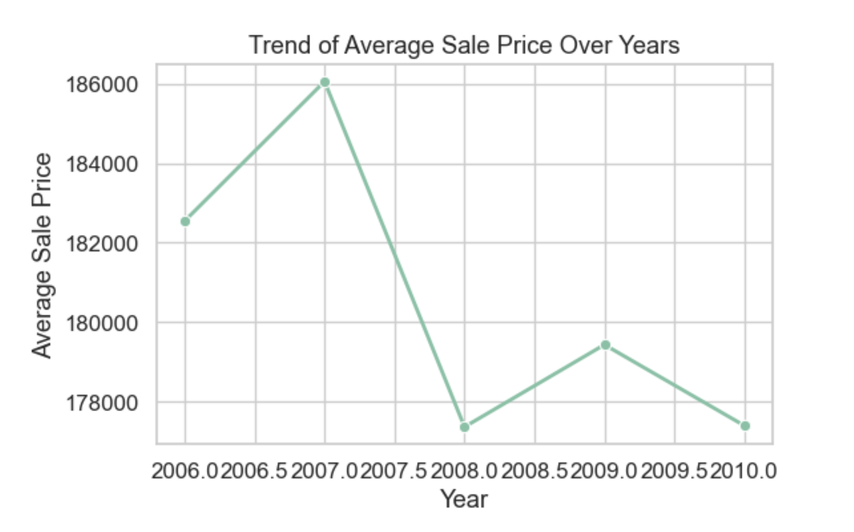
Market Trends and Historical Pricing

Slide 11
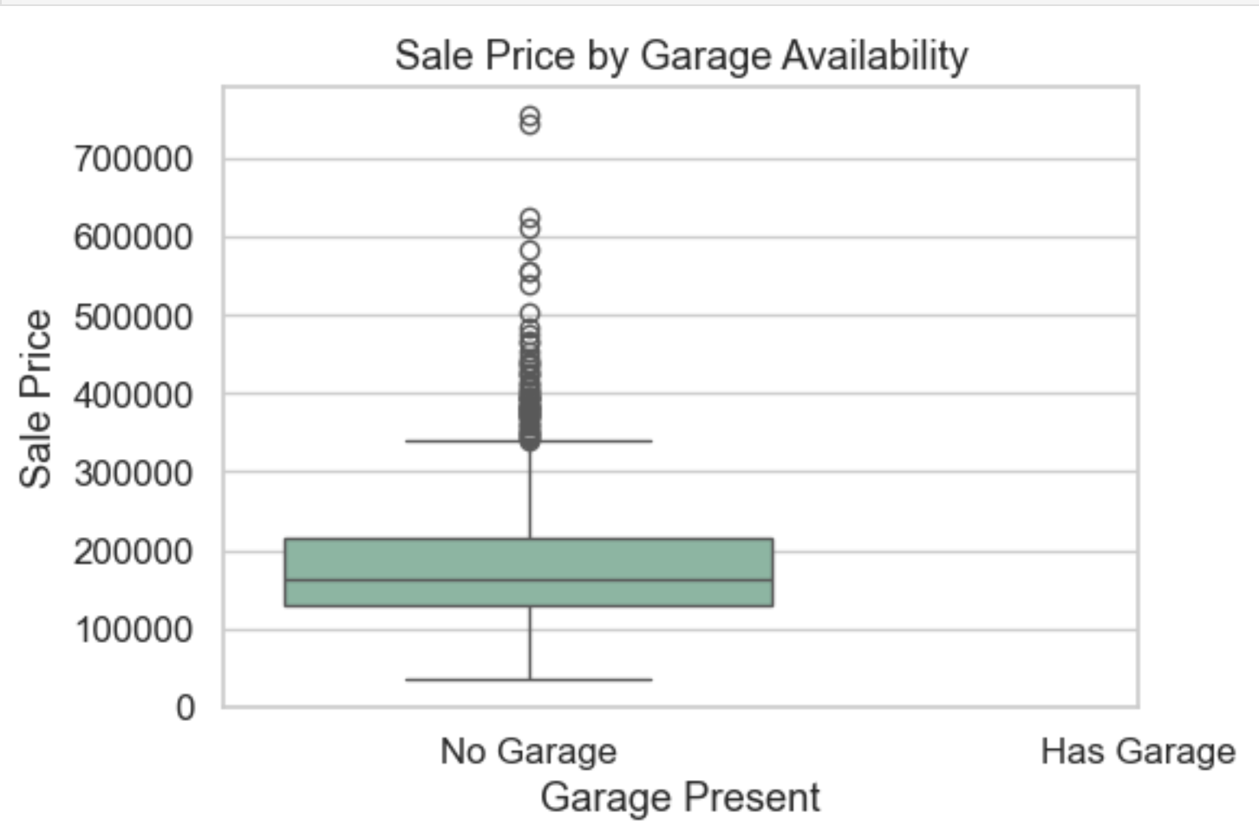
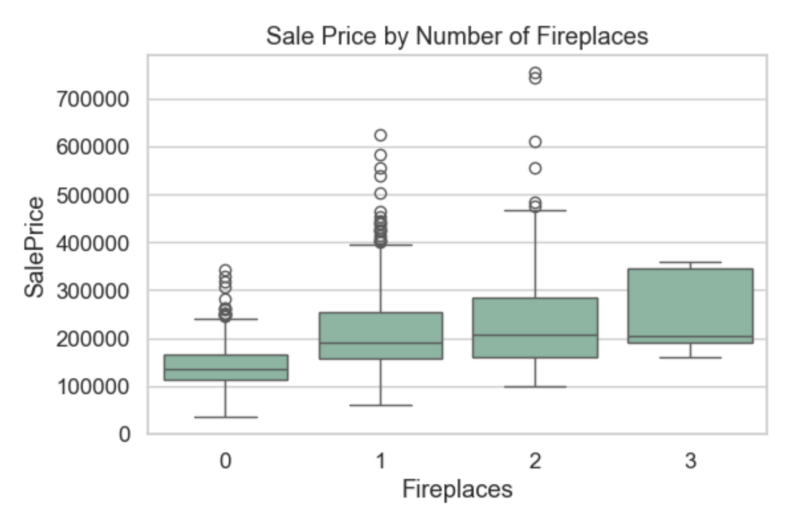
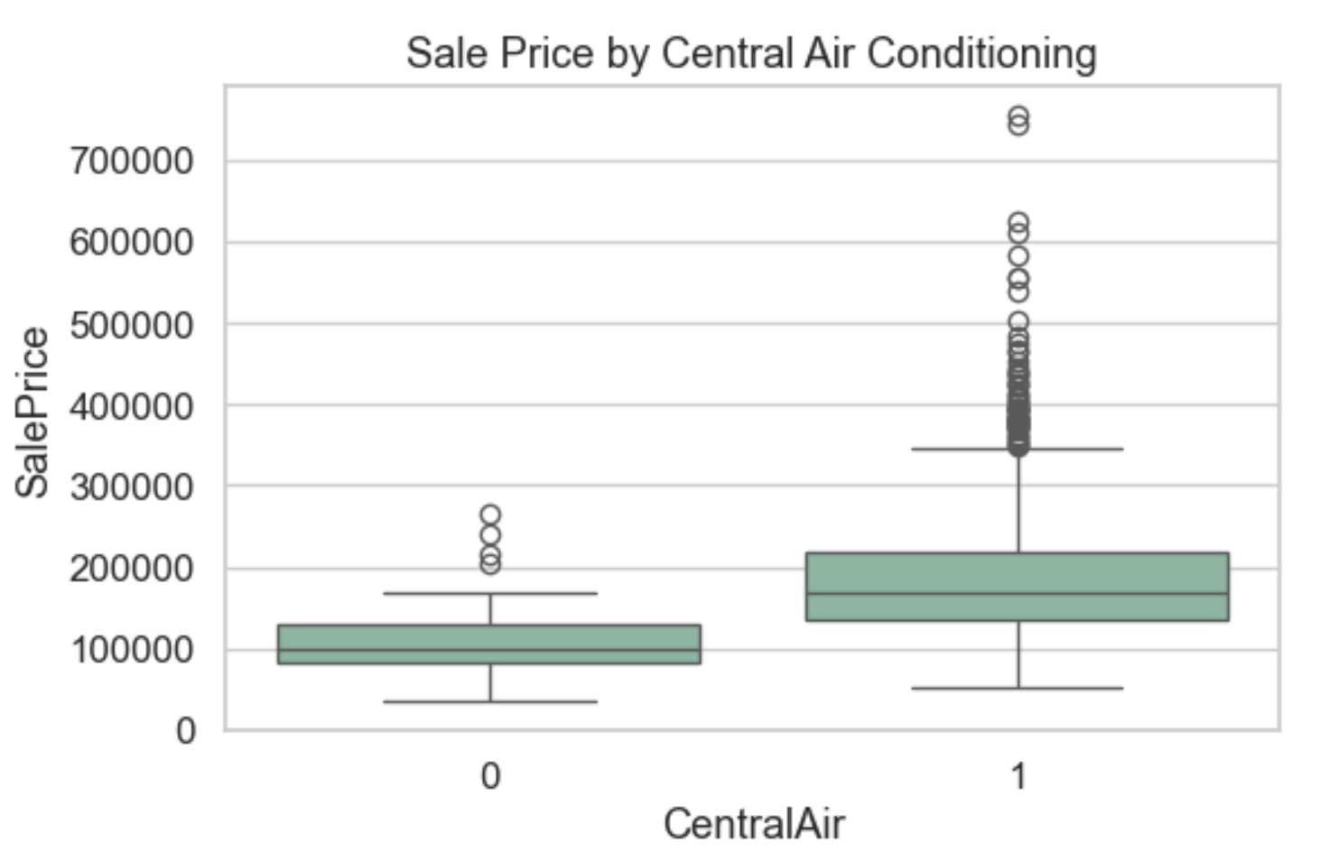
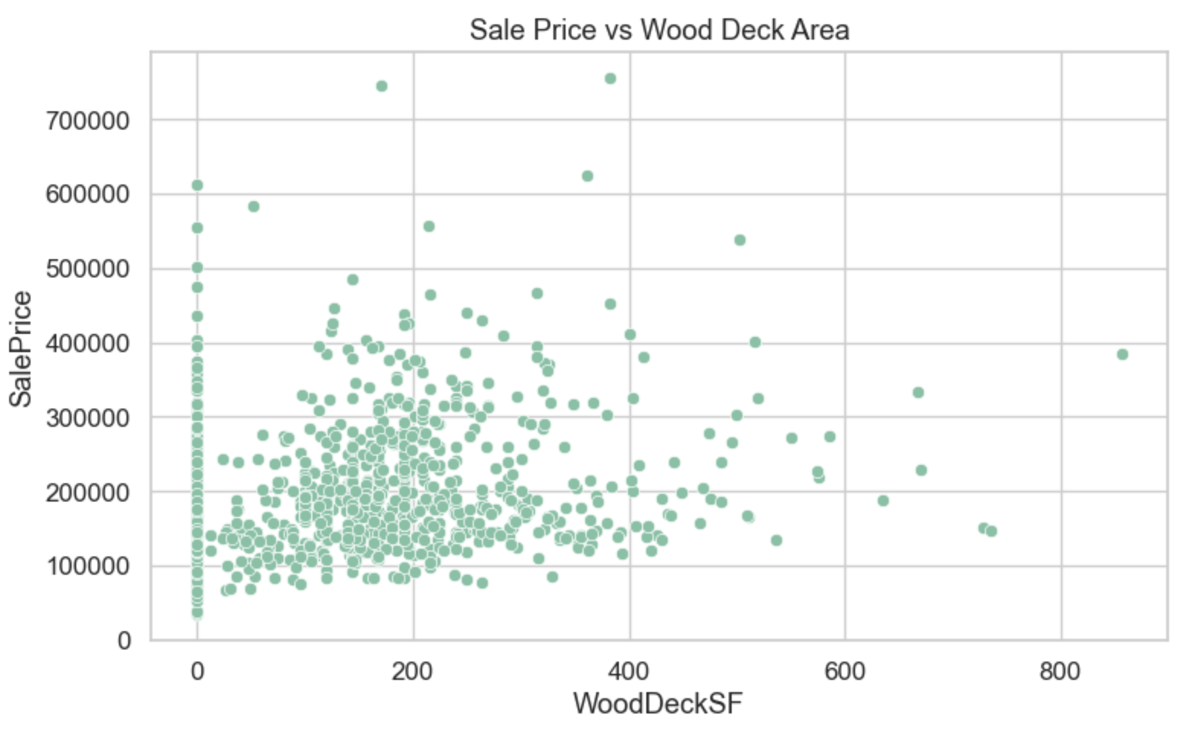
Customer Preferences and Amenities

Slide 12
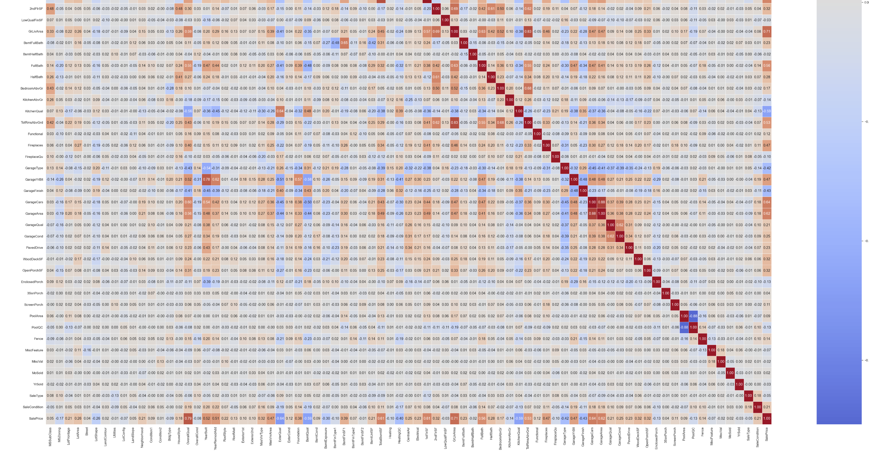
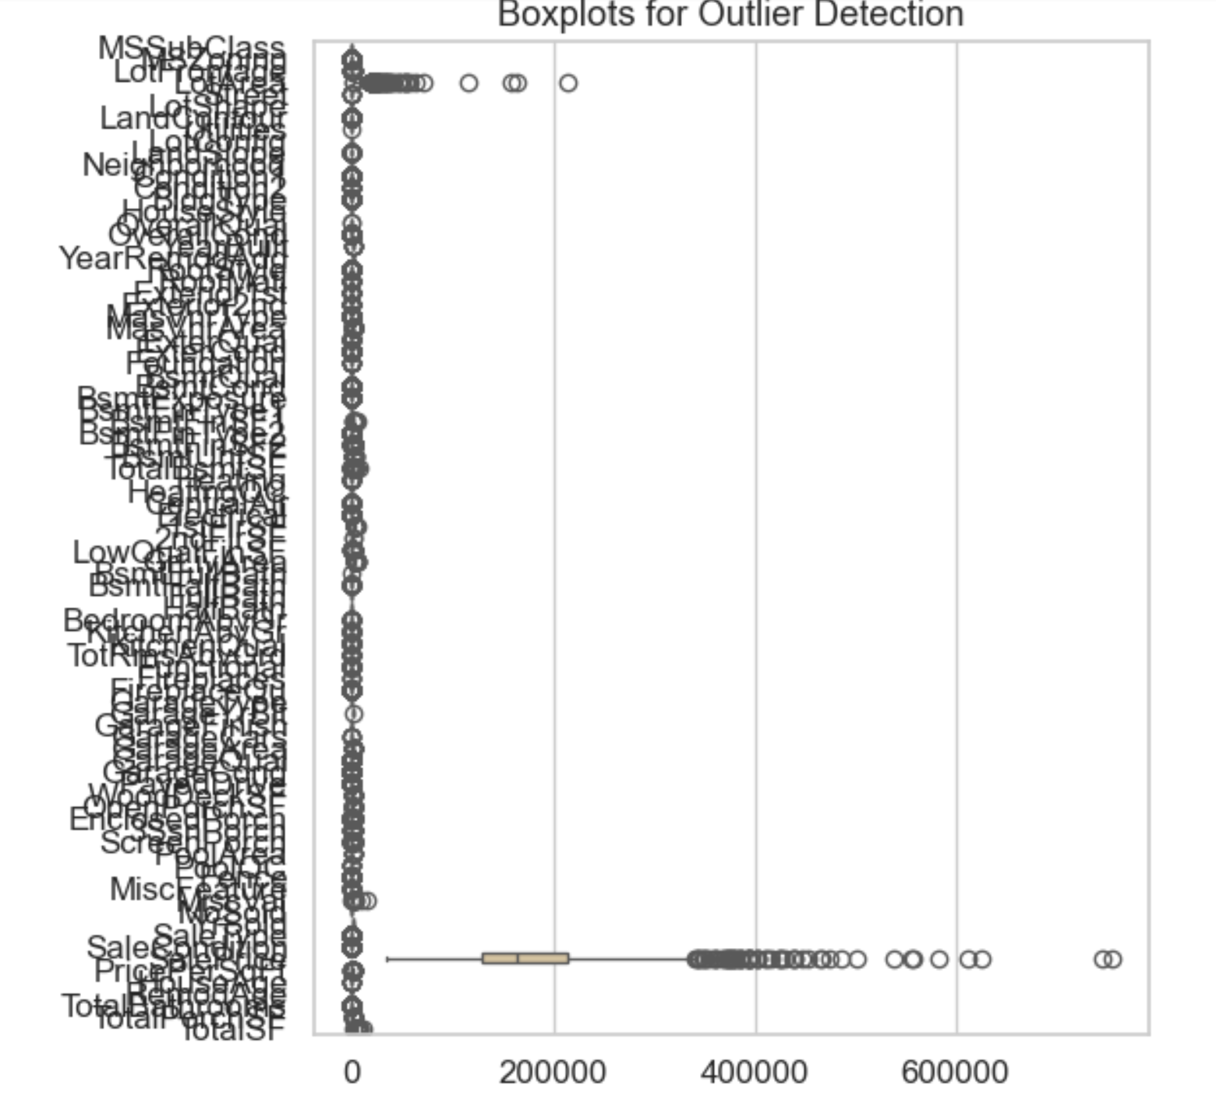
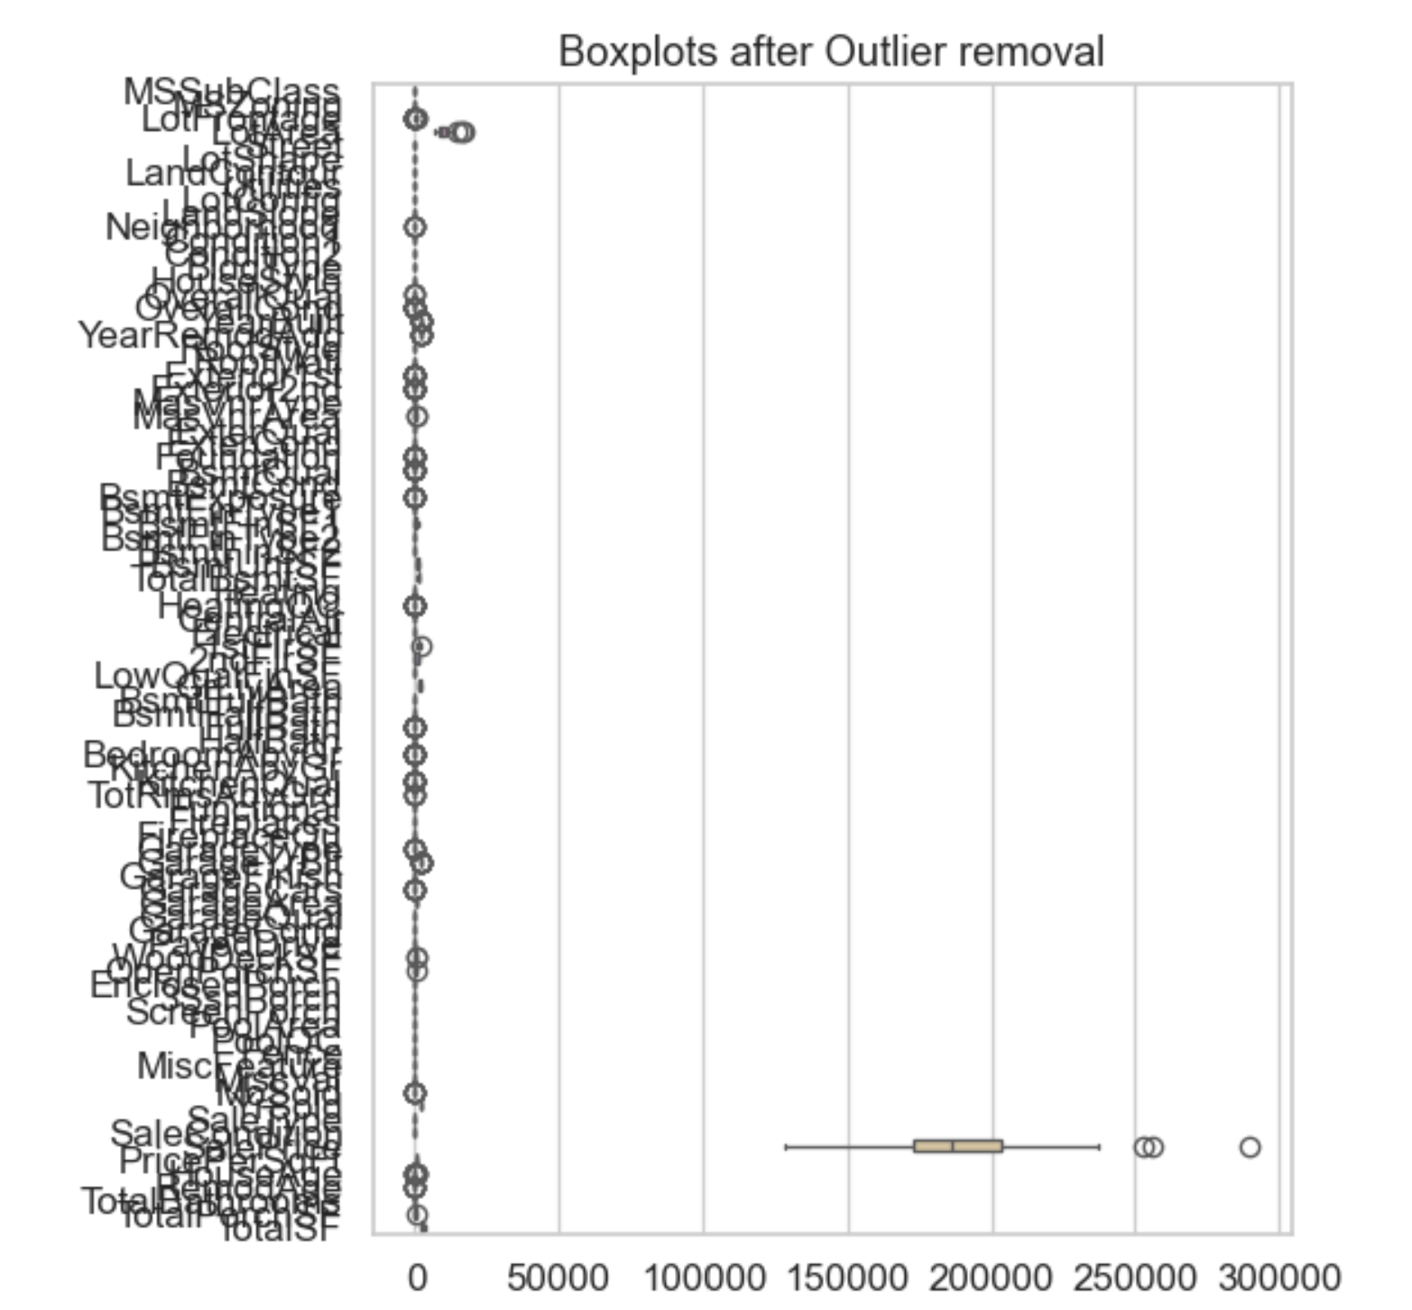
Correlation and Outliers

Slide 13
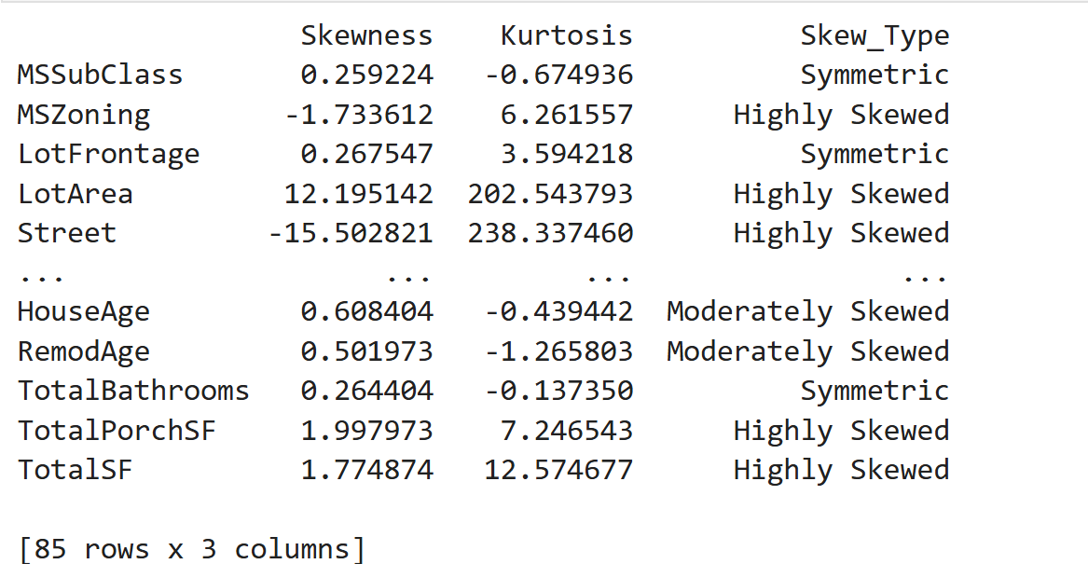
Skewness and Kurtosis

Slide 14
Thank You
Thank you for your time and attention!
Suggestions and feedback are welcome.

